Slide 1
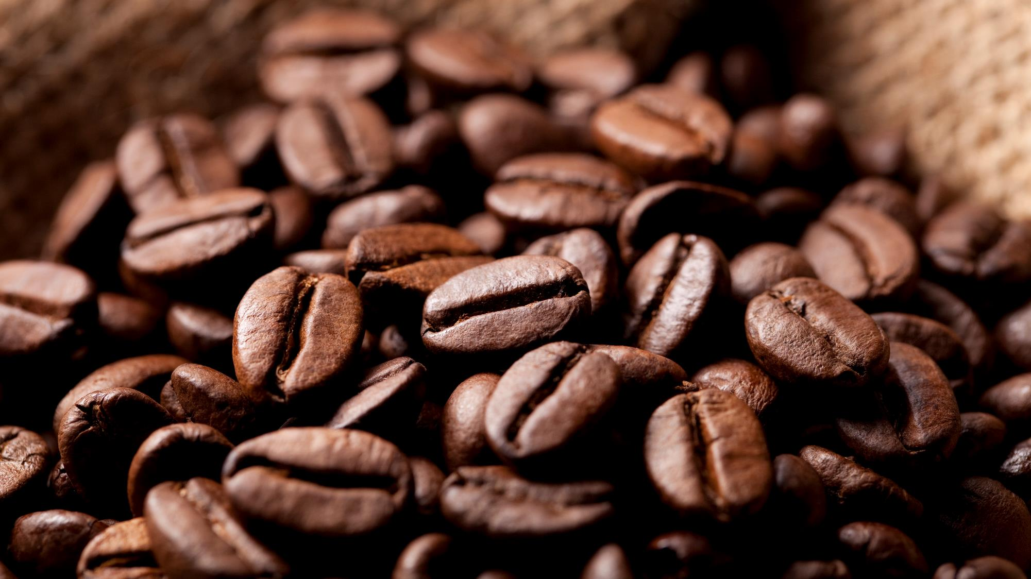
Coffee over time
Is your daily coffee cup leaving you broke?

Slide 2
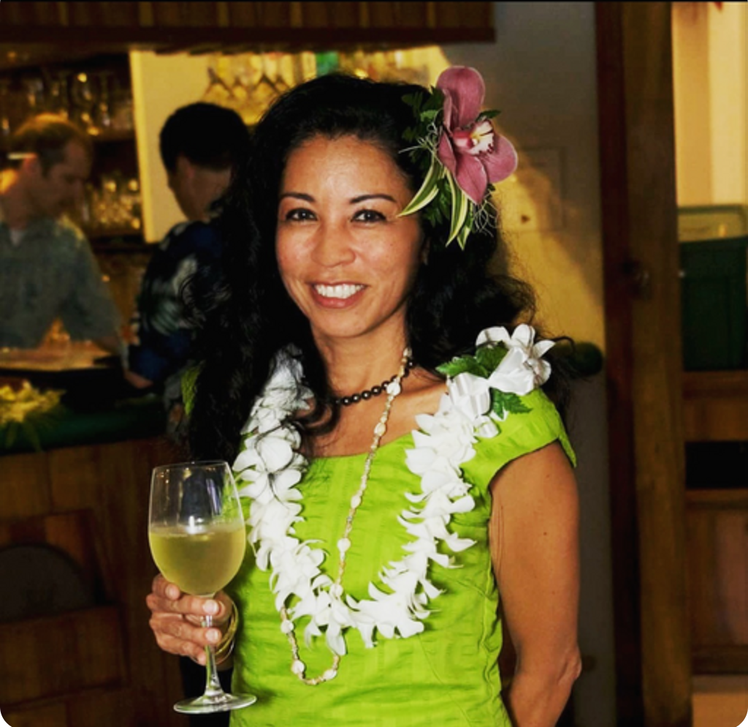



FINAL 3 Brewers
CHELSEA MILLER
GUSTAVO HERNANDEZ
HENRI TUDELA

Slide 3
Chelsea Miller

Slide 4
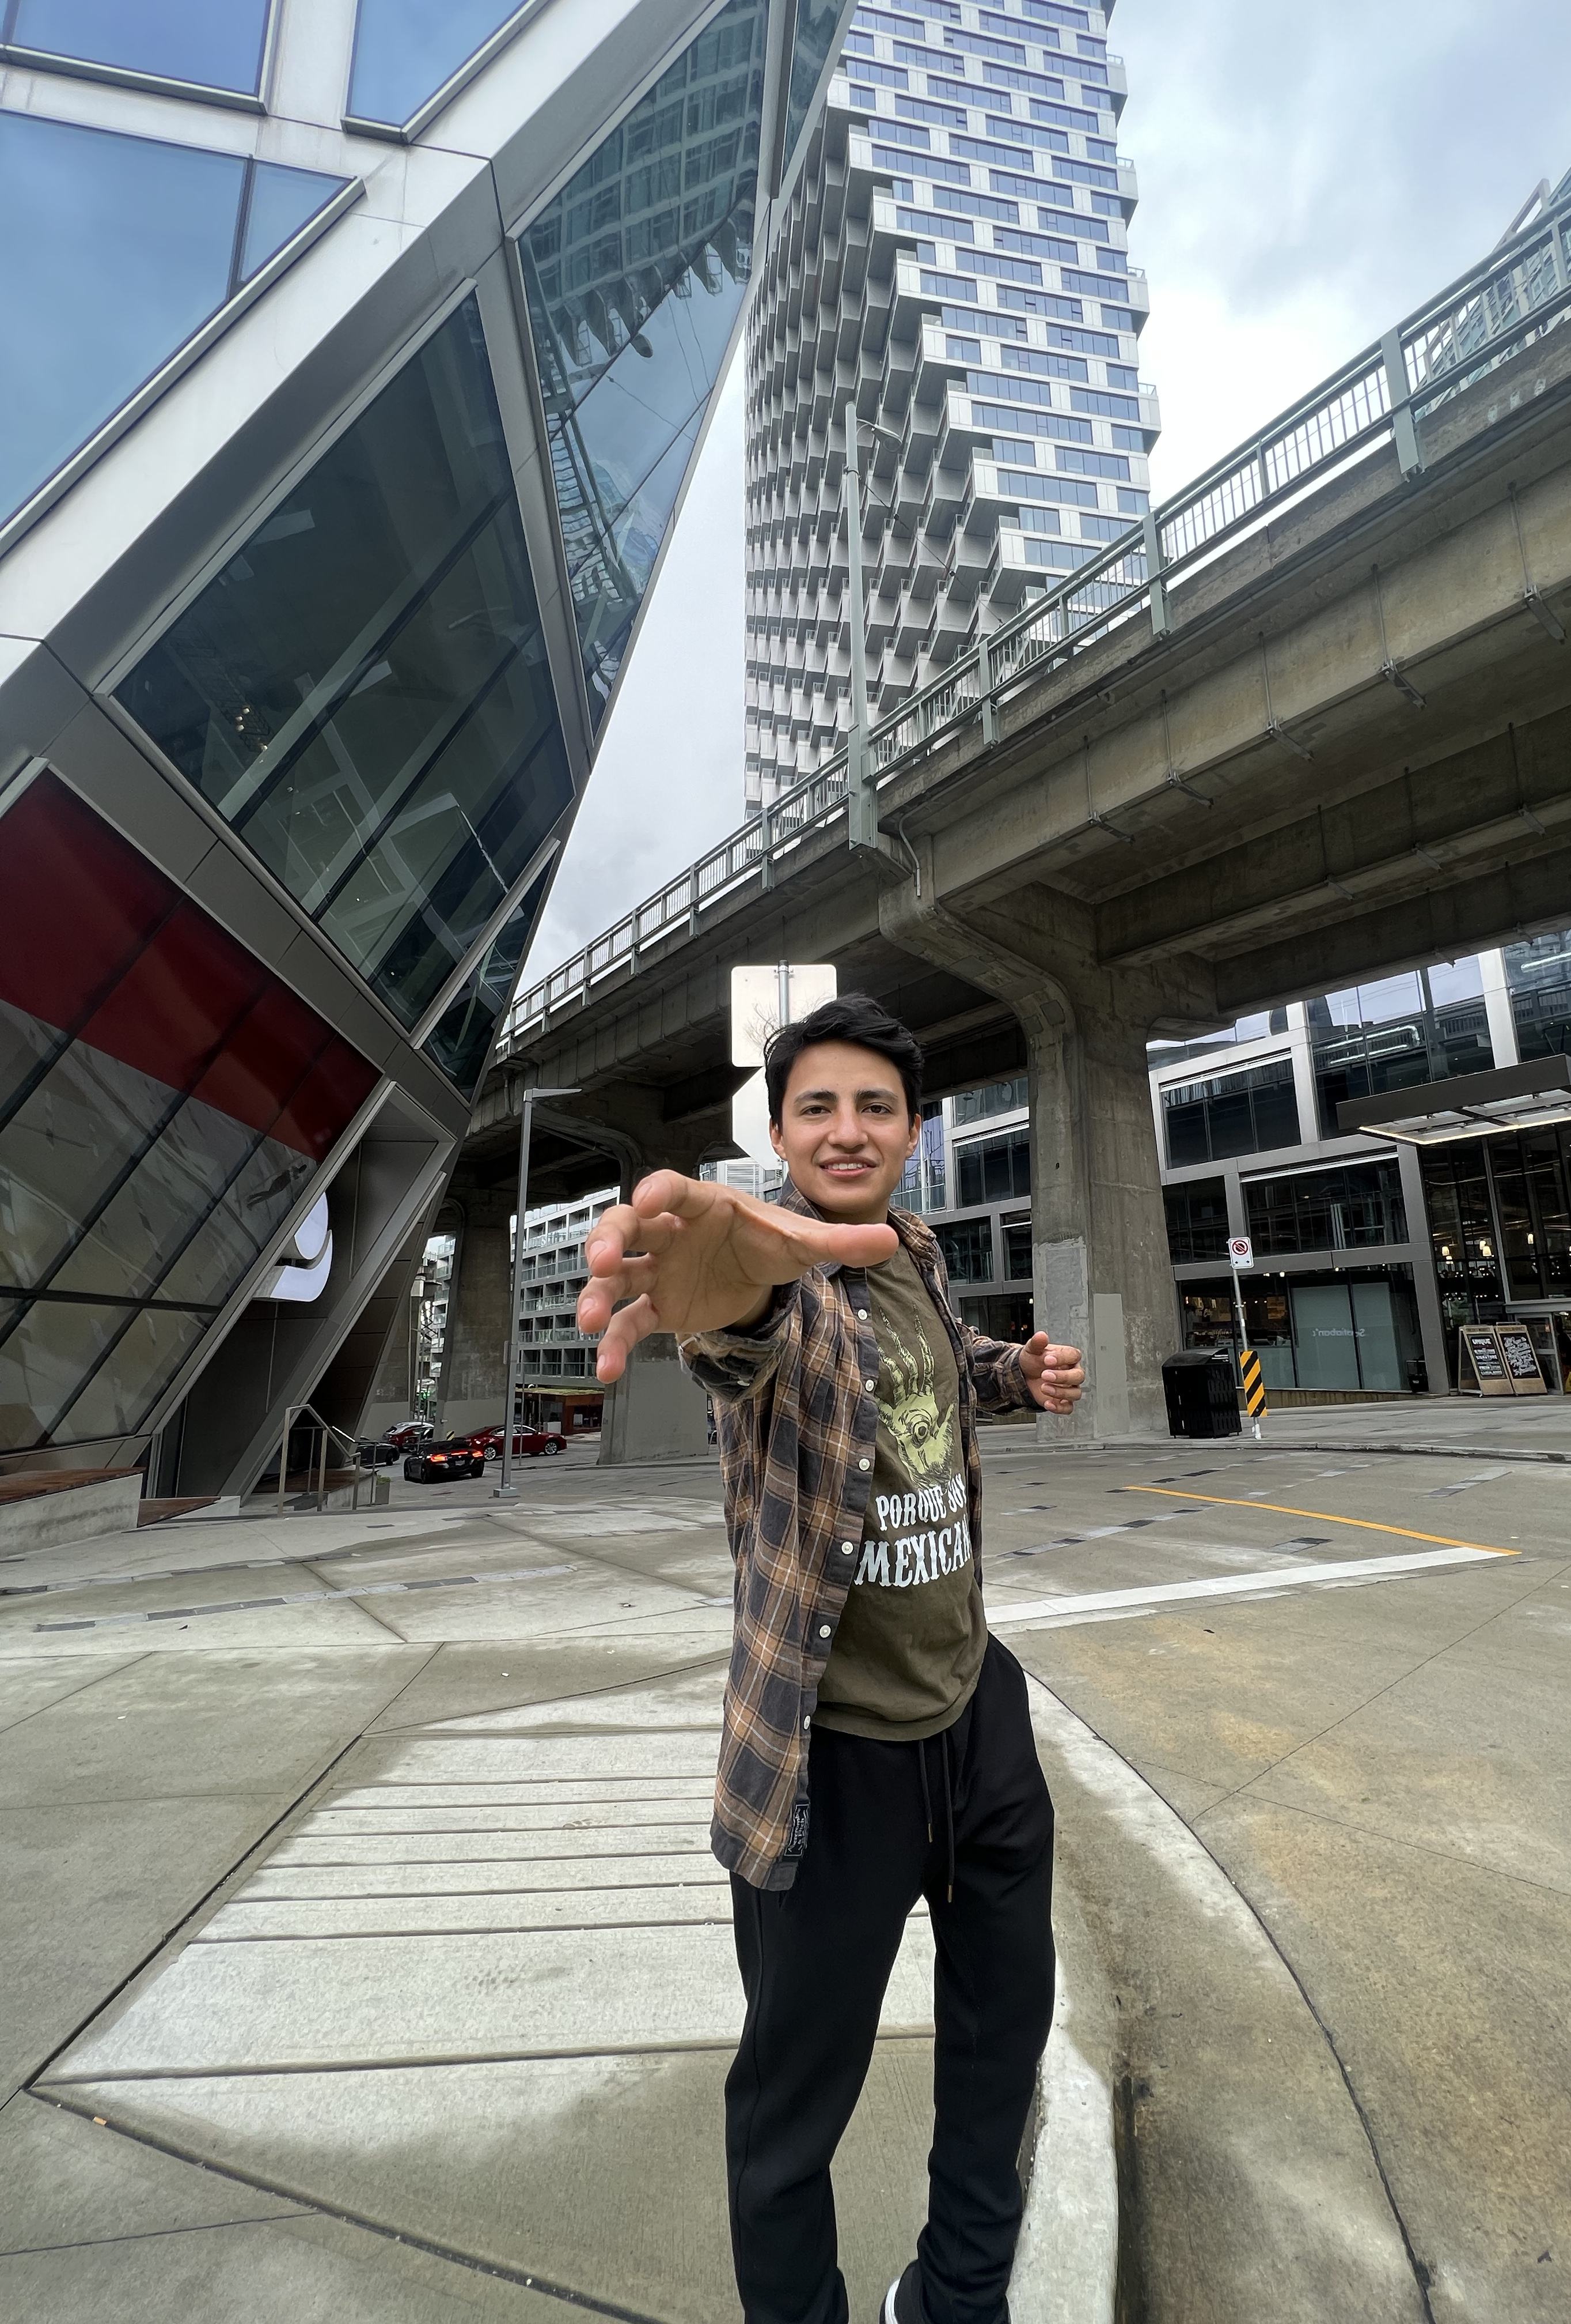
Gustavo A hernandez
My expertise areas are Economics and Mathematics. I love to work with topics that can have interesting results.
Education
(2022 – Present) Evergreen Valley College working in an Associates in Arts in Economics and going towards a 4-year University for a degree in Economics
(2021 – 2022) Southern Careers Institute Inc Powered By Woz-U - Certification in Data Science
(2017) Associates Degree in Accounting & Businesses Management – Mexico
Work Experience
(2021 – Present) Tesla Motors Inc – Production Associate
(2018 -2021) Easy-Pak LLC – Operator III
(2017 – 2018) Inbursa Bank – General Assistant (Mexico)

Slide 5
Henrietta (Henri) tudela

Slide 6
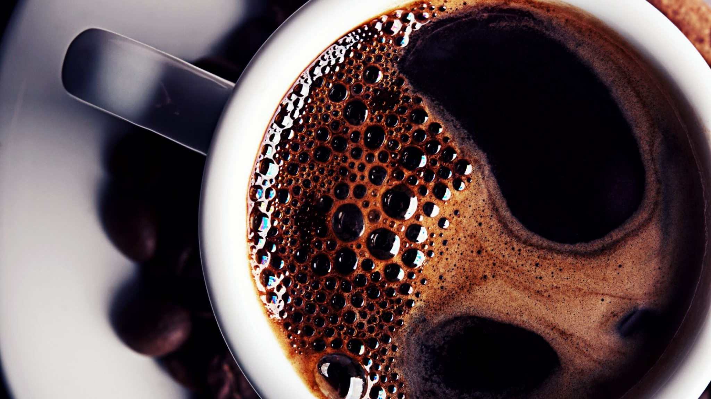
COFFEE
WHO DOES NOT LIKE COFFEE?

Slide 7
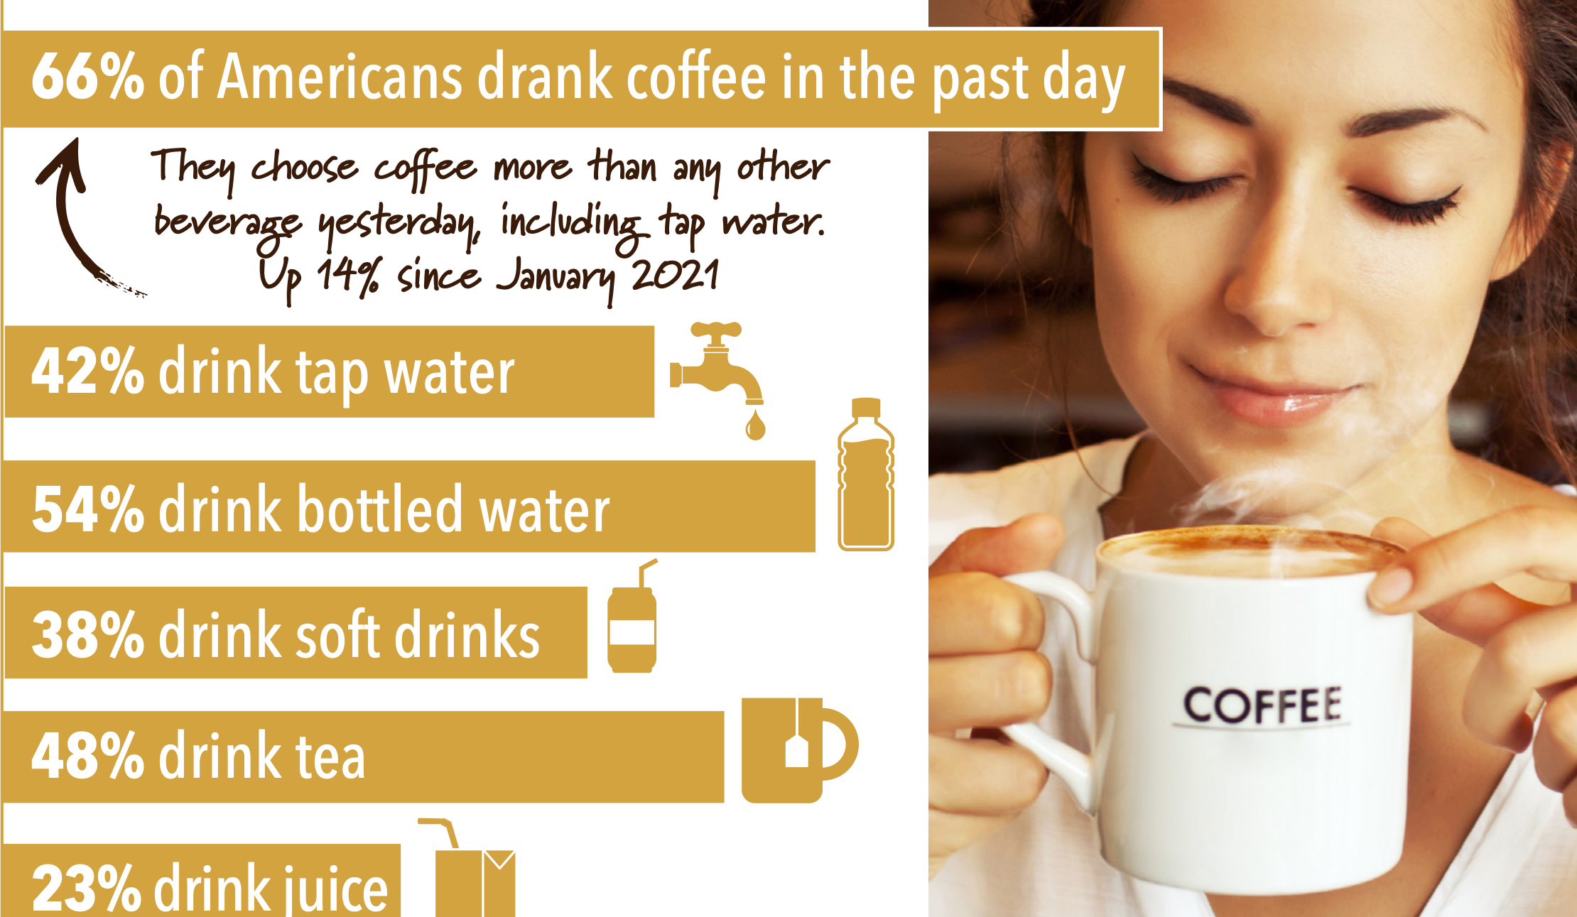
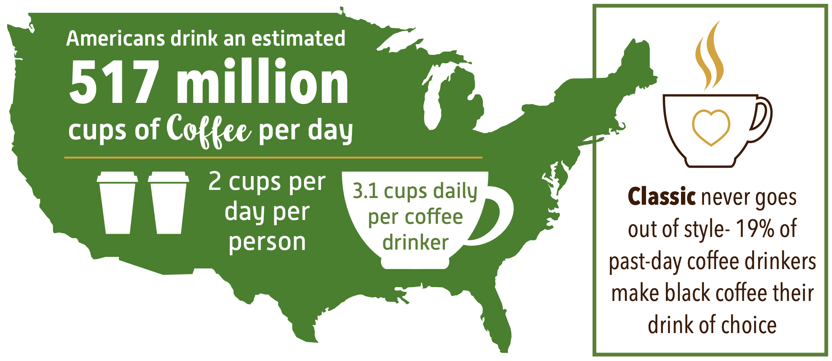
Coffee had been the world’s favorite drink this two last decades. The US has a population of 331,449,281 according to the 2020 CENSUS; and nearly the 66% of the population enjoy 2 cups of coffee every day.
https://www.ncausa.org/Research-Trends/Market-Research/NCDT
https://www.census.gov/library/visualizations/interactive/2020-population-and-housing-state-data.html

Slide 8
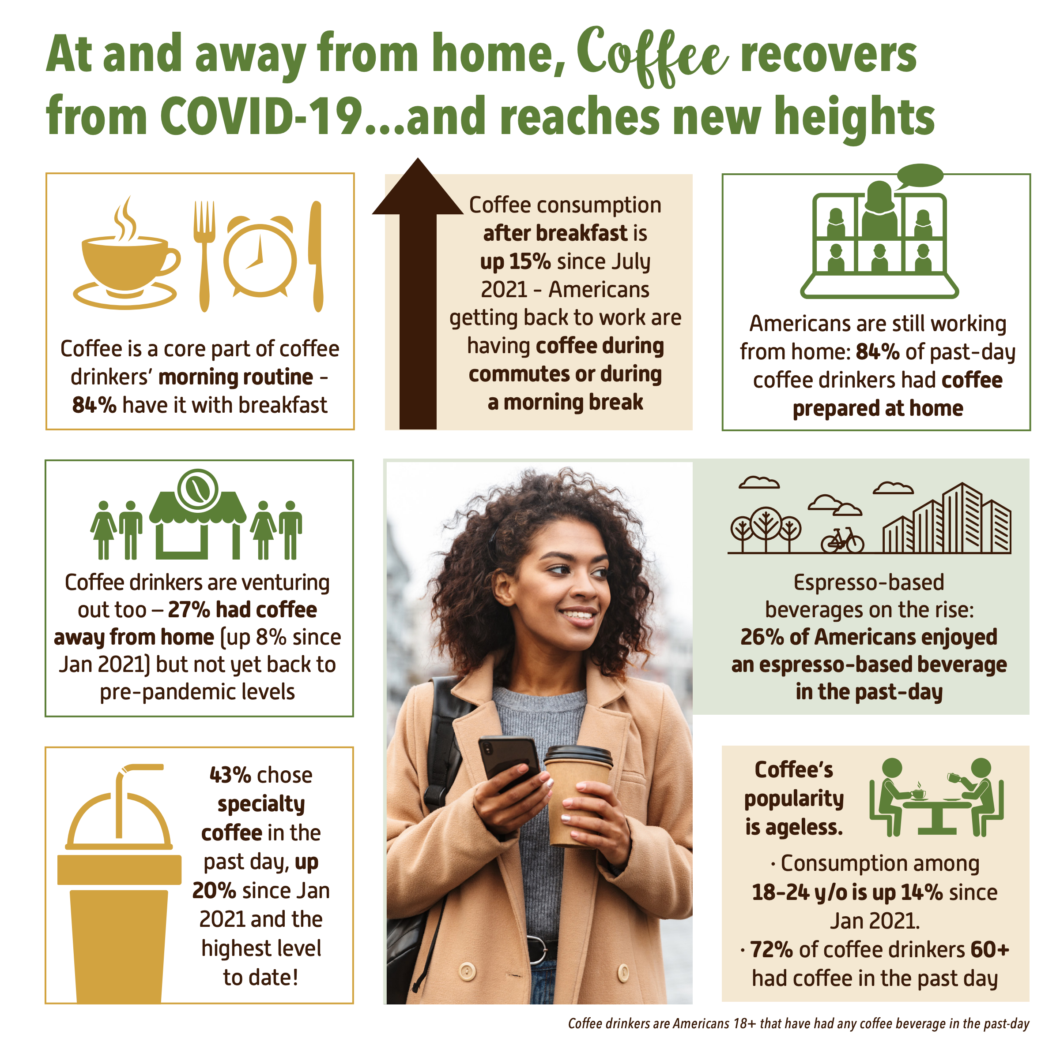

Did coffee defeated covid-19?
Coffee price in the Stock Market
Price per sack of 60kg
December 2020 $121.5 – February 2022 $246.2
Prices Increased by 203%

Slide 9
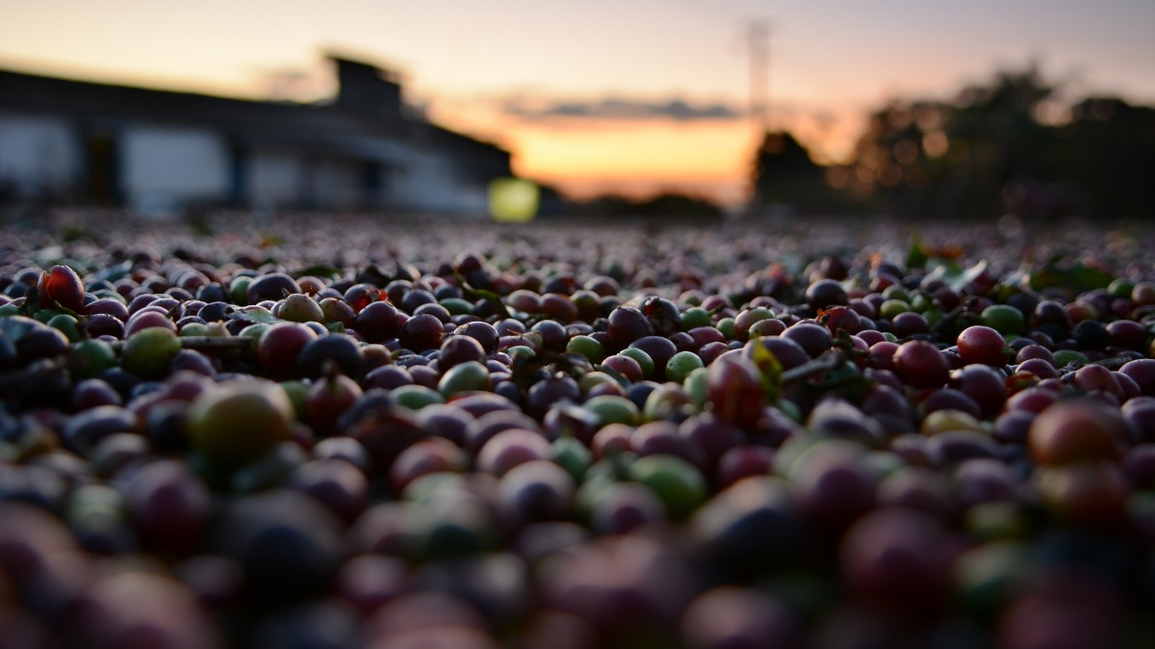
2011

Slide 10
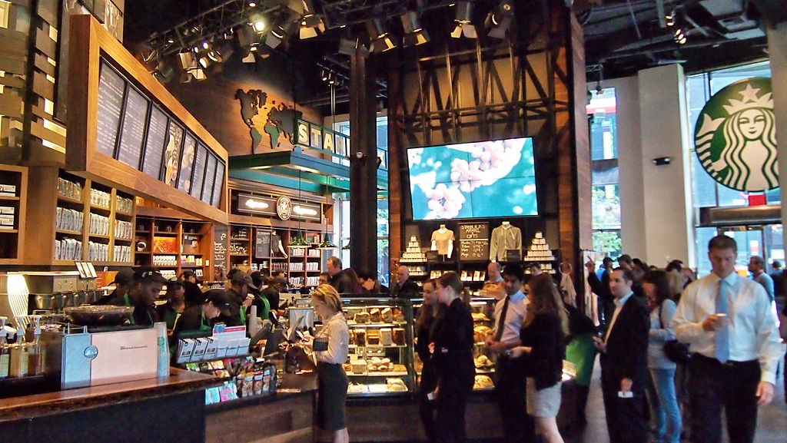
THE ONE-CENT STORM STARBUCKS MADE NEW YORKERS COUNT PENNIES IN 2011
In 2011 Starbucks increased the price of the tall coffee from $1.89 to $2.01 including taxes.
This event made New Yorkers change their lifestyles.
https://www.nytimes.com/2012/01/15/your-money/a-starbucks-price-increase-to-a-not-so-round-final-number.html
This Photo by Unknown Author is licensed under CC BY-SA

Slide 13
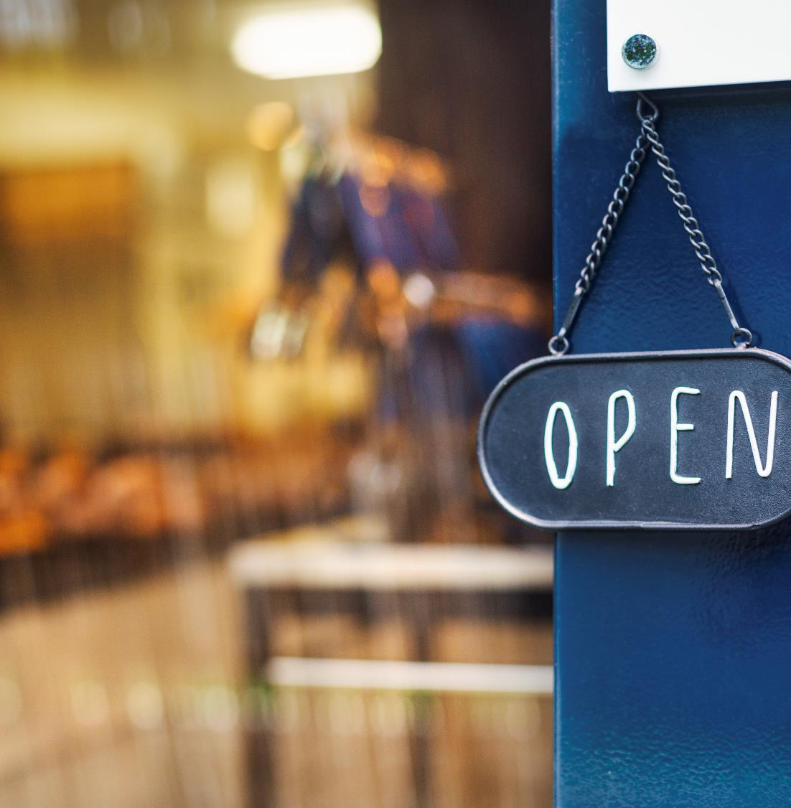

Thank You
Email somesone@example.com

